Slide 1
Basic Data Visualization
Presented By
Dhudukala Thapaswini

Slide 2
Project Overview
Data visualization helps transform raw numbers into meaningful and easy-to-understand visuals.
This project focuses on exploring the Iris dataset using different types of charts and plots.
Bar plots were used to compare measurements across different flower species.
Line charts helped observe trends and variations within the dataset.
Scatter plots were created to understand the relationship between numerical features.
Labels, titles, and legends were customized to make the visualizations clear and informative.
The generated charts were exported as image files for use in reports and presentations.
Through this project, we gained hands-on experience in presenting data in a visually appealing and insightful manner using Python libraries such as Matplotlib and Seaborn.

Slide 3
Dataset Description
The Iris dataset is one of the most well-known datasets in the field of data science and machine learning.
It was originally introduced by the British statistician and biologist Ronald A. Fisher in 1936 for classification studies.
The dataset contains measurements of iris flowers belonging to three different species.
It is widely used for learning data analysis, visualization, and machine learning concepts because of its simplicity and well-structured format.
The dataset consists of 150 observations (rows) and 5 columns (features). Each observation represents a single iris flower sample with its corresponding measurements.
The three species included in the dataset are:
Setosa
Versicolor
Virginica

Slide 4
Four columns contain numerical measurements of the flowers: Sepal Length (cm): Length of the outer leaf-like part of the flower.
Sepal Width (cm): Width of the sepal.
Petal Length (cm): Length of the petal.
Petal Width (cm): Width of the petal.
The fifth column, Species, is a categorical feature indicating the type of iris flower.
The dataset does not contain missing values, making it ideal for beginners to practice data visualization techniques.
Its balanced distribution across the three species makes it useful for identifying patterns, comparing categories, and understanding relationships between variables through charts and plots.

Slide 5
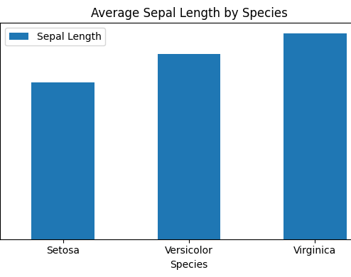
Bar Plot Analysis [Visualization: Average Sepal Length by Species]
The bar plot compares the average sepal length of the three Iris flower species.
Virginica has the highest average sepal length, while Setosa has the lowest.
The differences in bar heights clearly show the unique characteristics of each species.
This visualization makes category-wise comparisons simple, helping us interpret the data quickly and effectively.

Slide 6
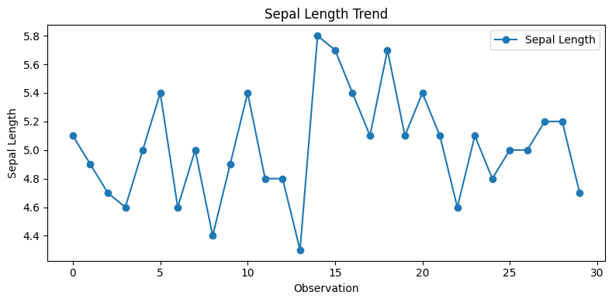
Line Chart Analysis [Visualization: Sepal Length Trend]
The line chart illustrates the trend and variation in sepal length measurements across different observations in the dataset.
It shows that the values fluctuate naturally, with no sudden spikes or unusual patterns.
This visualization helps identify how the measurements change from one sample to another in a sequential manner.
Line charts are useful for understanding trends and recognizing patterns that may not be evident from raw data alone.

Slide 7
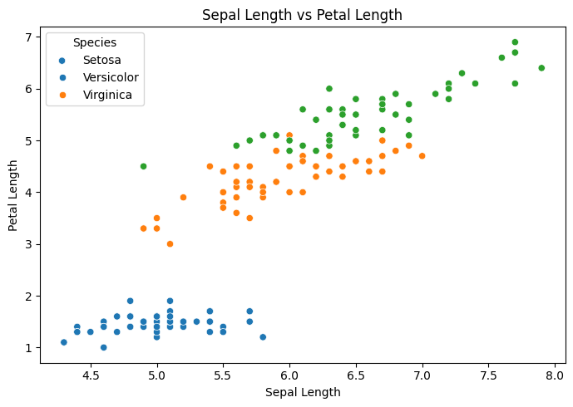
Scatter Plot Analysis [Visualization: Sepal Length vs Petal Length]
The scatter plot illustrates the relationship between sepal length and petal length in the Iris dataset.
A positive relationship can be observed, indicating that flowers with longer sepals generally tend to have longer petals.
The data points form distinct clusters, showing clear differences among the three Iris species.
This visualization helps identify patterns, correlations, and natural groupings within the dataset more effectively than raw numerical values.

Slide 8
Key Insights
The Iris dataset contains distinct characteristics that help differentiate the three flower species.
Virginica generally exhibits larger measurements, particularly in sepal length, compared to the other species.
The bar plot effectively highlights differences in average sepal length among the species.
The line chart reveals natural variations in measurements without any unusual fluctuations or extreme values.
The scatter plot shows a positive relationship between sepal length and petal length, indicating that these features tend to increase together.
Clear clustering in the scatter plot suggests that the species have unique patterns and can be visually distinguished.
Data visualizations simplify complex numerical information, making it easier to identify trends, relationships, and insights.

Slide 9
Conclusion
This project demonstrated how data visualization can transform raw data into meaningful and easy-to-understand insights.
By creating bar plots, line charts, and scatter plots, we explored patterns, trends, and relationships within the Iris dataset.
The visualizations helped compare species characteristics and identify correlations between different features.
Customizing charts with appropriate labels, titles, and legends improved the clarity and presentation of the findings.
Overall, this task enhanced our practical skills in Python, Matplotlib, and Seaborn while highlighting the importance of visual storytelling in data analysis.

Slide 10


Slide 11


